Slide 1
Python File Handling

Slide 2
File handling
File handling is an important part of any web application.
Python has several functions for creating, reading, updating, and deleting files.
Python file open
Python file read/write
Python file close
Python file delete

Slide 3
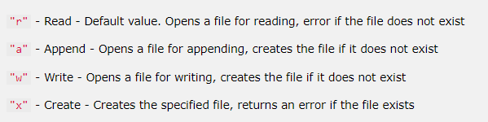

Python File Open
The key function for working with files in Python is the open() function.
The open() function takes two parameters; filename, and mode.
There are four different methods (modes) for opening a file:

Slide 4
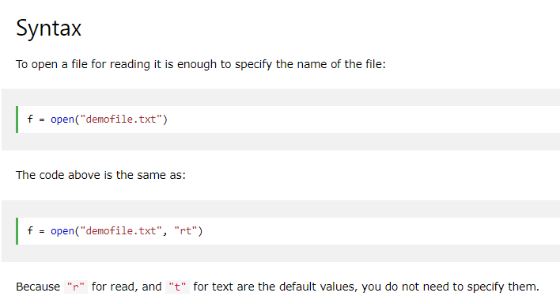

Slide 5
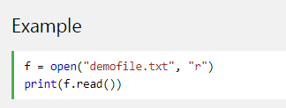
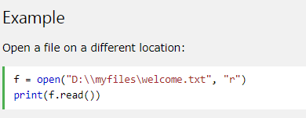
Python read files
The open() function returns a file object, which has a read() method for reading the content of the file:
If the file is located in a different location, you will have to specify the file path, like this:

Slide 6
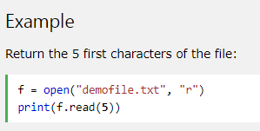
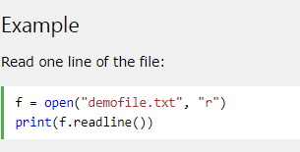
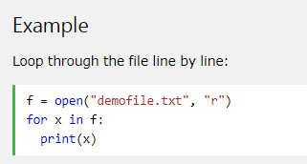
Read Only Parts of the File
By default the read() method returns the whole text, but you can also specify how many characters you want to return:
You can return one line by using the readline() method:

Slide 7
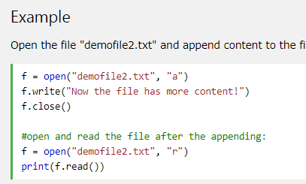
Python File Write
Write to an Existing File
To write to an existing file, you must add a parameter to the open() function:
"a" - Append - will append to the end of the file
"w" - Write - will overwrite any existing content

Slide 8
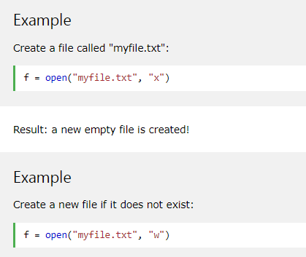
Create a New File
To create a new file in Python, use the open() method, with one of the following parameters:
"x" - Create - will create a file, returns an error if the file exist
"a" - Append - will create a file if the specified file does not exist
"w" - Write - will create a file if the specified file does not exist

Slide 9
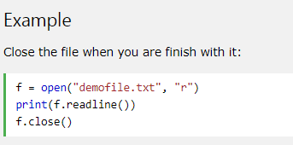
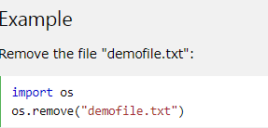
Close Files
Delete a File

